Slide 1
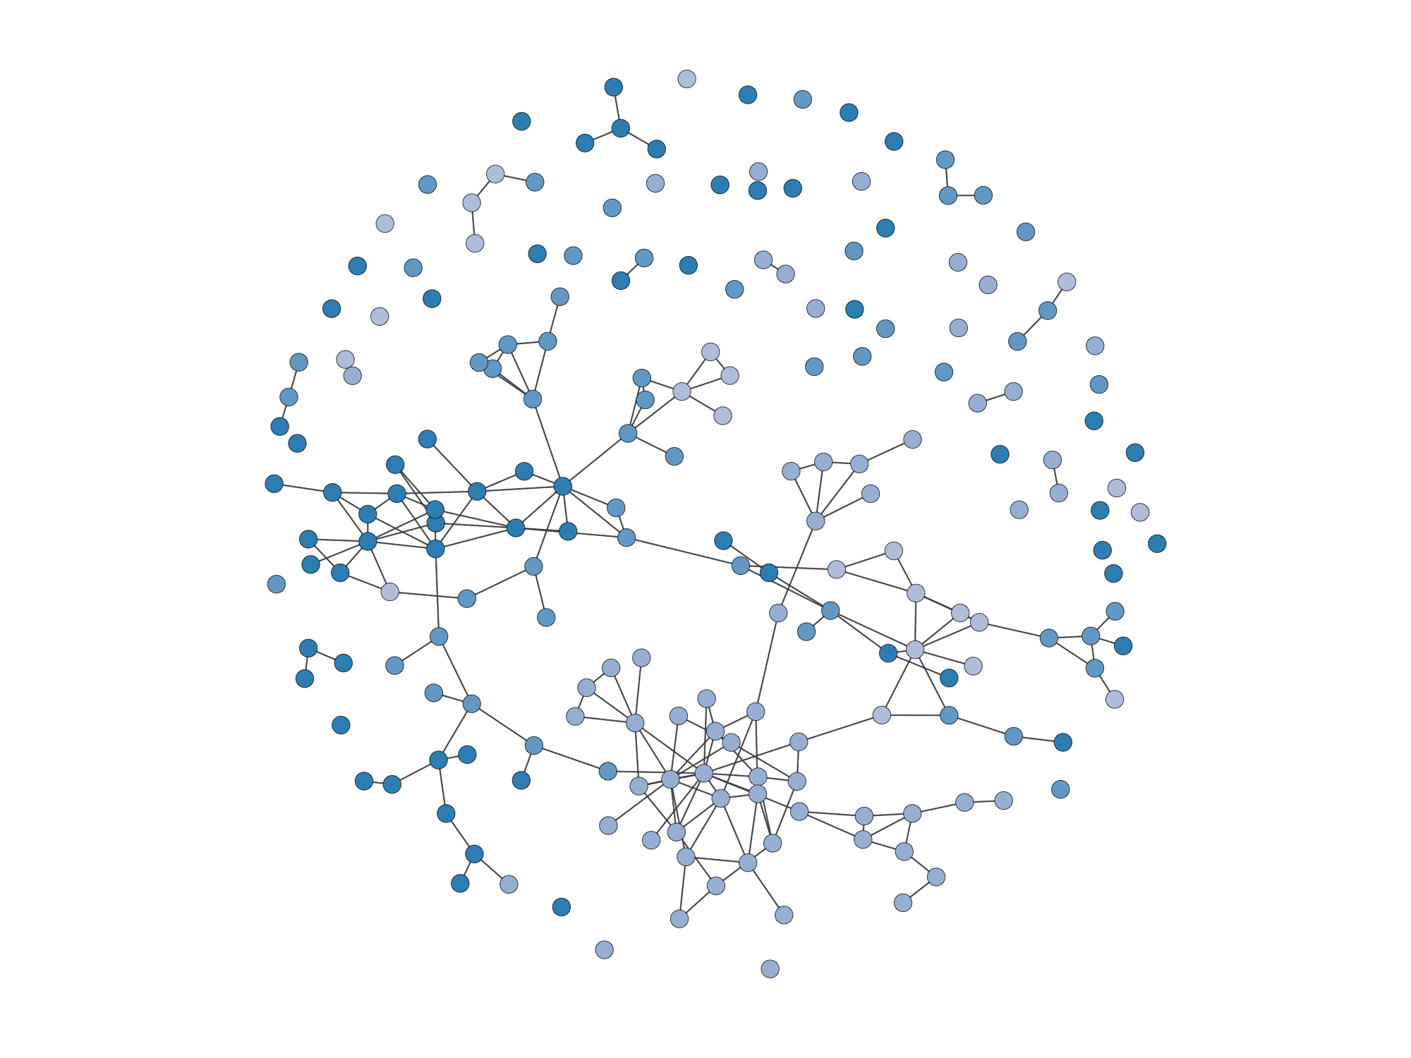

Rooted America: Immobility and Segregation of Inter-county Migration Networks
Peng Huang
Departments of Sociology, and Statistics
Networks, Computation, and Social Dynamics Lab (NCASD)
University of California, Irvine
Notes:
diss chap, forthcoming at

Slide 2

Research Profile
Population
Space
Society
Network and Computational Models
Notes:
Demographer, network researcher, and statistician by training
Social Problems arising from the interactions among
enables me to utilize large-scale demographic and network data

Slide 3
Research Profile
Migration and demographic change
Neighborhood and population health
Methods for large-scale dynamic data
Notes:
Neighborhood: mainly from a social network perspective

Slide 4
“Is California losing population to other U.S. states?”
Migration
“How has international visa-waiver policy networks evolved?”
Neighborhood
“What explains racial disparity in COVID-19 infection risks?”
Methods
“How to compute large network models?”
Notes:
Some examples of the questions I ask in my articles include:

Slide 5
“Americans today are not migrating. Why?”

Slide 6

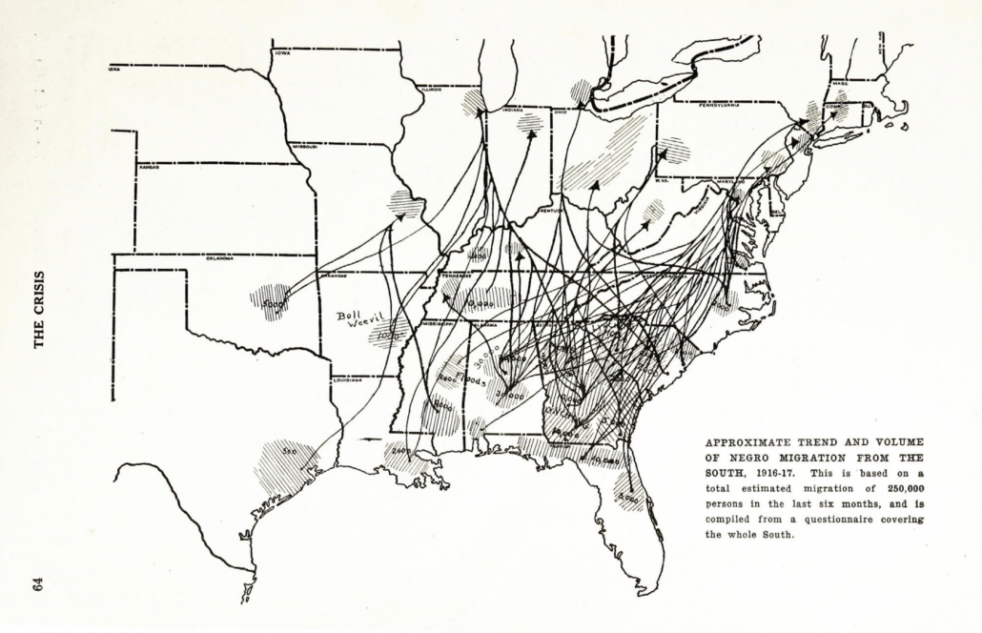
America: a rootless society
Migration from the Dust Bowl
The Great Migration of African Americans
By W. E. B. DuBois (1917) in The Crisis
Introduction | Background | Hypotheses | Data&Methods | Results | Discussion
Notes:
In American culture and history, migration has always been considered as a common practice
during the great depression
~6 million
20th century 1910-1970
https://reimaginingmigration.org/w-e-b-dubois-migration-of-negros-1917/

Slide 7
Moving within America
Americans today don’t move
Why?
Source: Molloy, Smith, and Wozniak 2011
Introduction | Background | Hypotheses | Data&Methods | Results | Discussion
Notes:
This is supported by the following data
Def of mig: different residency 1yr ago
Across four regions: West, Midwest, Northeast, and the South
-
-CPS: less effort in following up non-response, under-estimating migration
growing discrepancy in response to CPS migration question and their administrative record (Hyatt et al. 2018), why is still unknown

Slide 8
What influences migration?
Migration is a demographic phenomenon
life-course event
age matters, marital status matters, etc.
Migration is an economic phenomenon
migration happens when it brings net profit (Todaro 1976)
job opportunities, living costs matter, etc.
Introduction | Background | Hypotheses | Data&Methods | Results | Discussion

Slide 9
They do not explain this immobility
Researchers found little supporting evidence that the low migration rate can be explained by (e.g., Hyatt and Spletzer 2013; Hyatt et al. 2018; Molloy et al. 2011, 2017):
demographic and socioeconomic structures of population
labor market composition
housing market properties
others: occupational licensing, health-insurance retainment
Introduction | Background | Hypotheses | Data&Methods | Results | Discussion
Notes:
Mainly economists
Kudos to journals that publish papers with null results

Slide 10
Puzzle: What inhibits migration?
“Mobility bias” in migration studies (Schewel 2020)
Social scientists have studied extensively about what drives migration (financial, social, political capital etc.)
Much less is known about what inhibits migration
Introduction | Background | Hypotheses | Data&Methods | Results | Discussion
Notes:
It is a question that is relevant to migration generally speaking, beyond the American context
If you open a book or a journal about migration

Slide 11
Puzzle: What inhibits migration?
Study case: U.S. internal migration in 2011-5
Move beyond demographic and economic factors
a comprehensive survey of the social institutions that influence migration
Reflect on the analytic framework of migration research
how shall we study migration
Introduction | Background | Hypotheses | Data&Methods | Results | Discussion

Slide 12
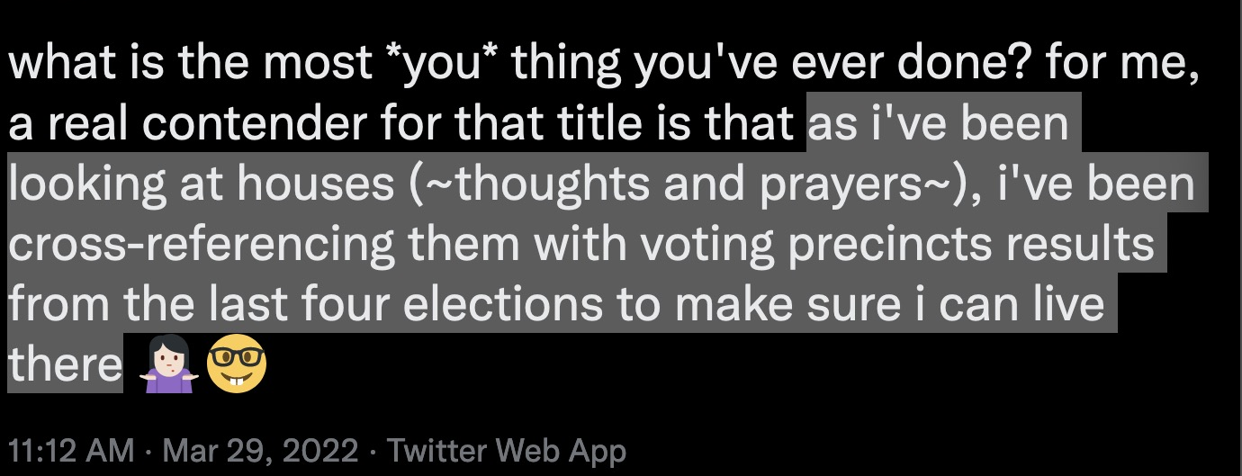
What influences migration...
besides demographic and economic factors?
Introduction | Background | Hypotheses | Data&Methods | Results | Discussion
Notes:
Here is a tweet from a colleague that I found inspiring. I’m going to read it out.
It might be a little bit nerdy to make a data-driven personal decision, but this is definitely not a *you* thing
---this is especially the case in today's polarized world. But it is nothing new

Slide 13
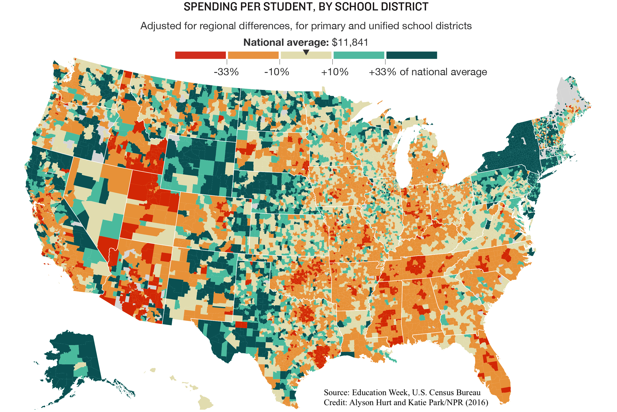
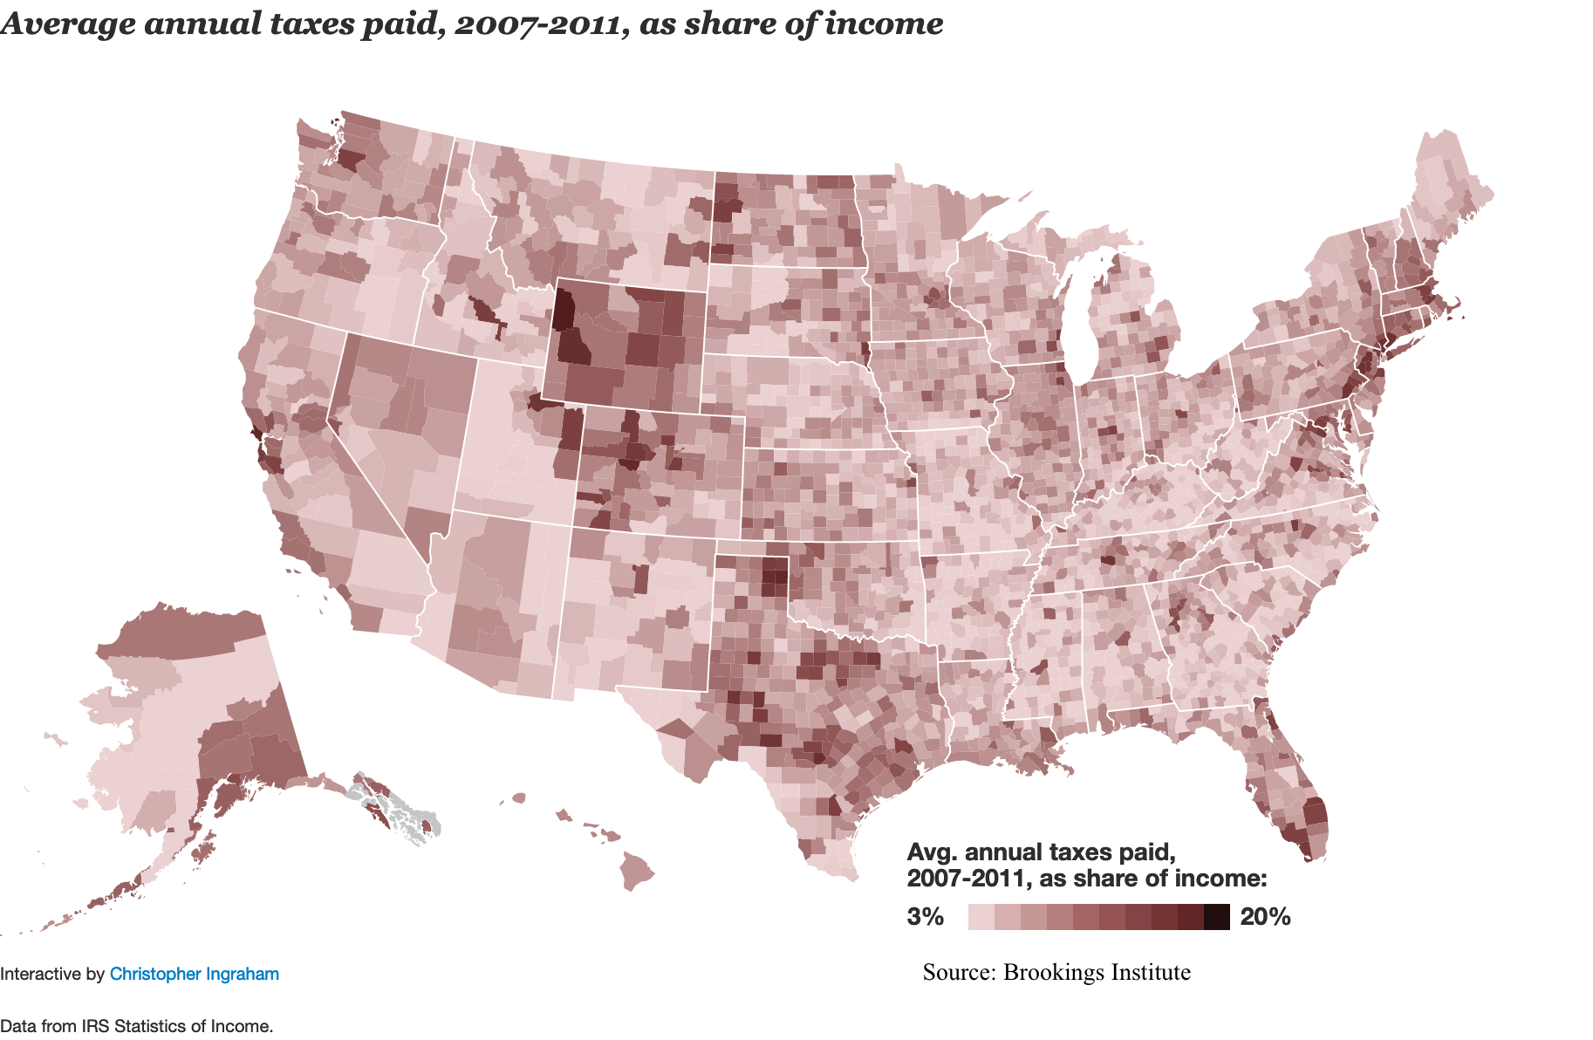
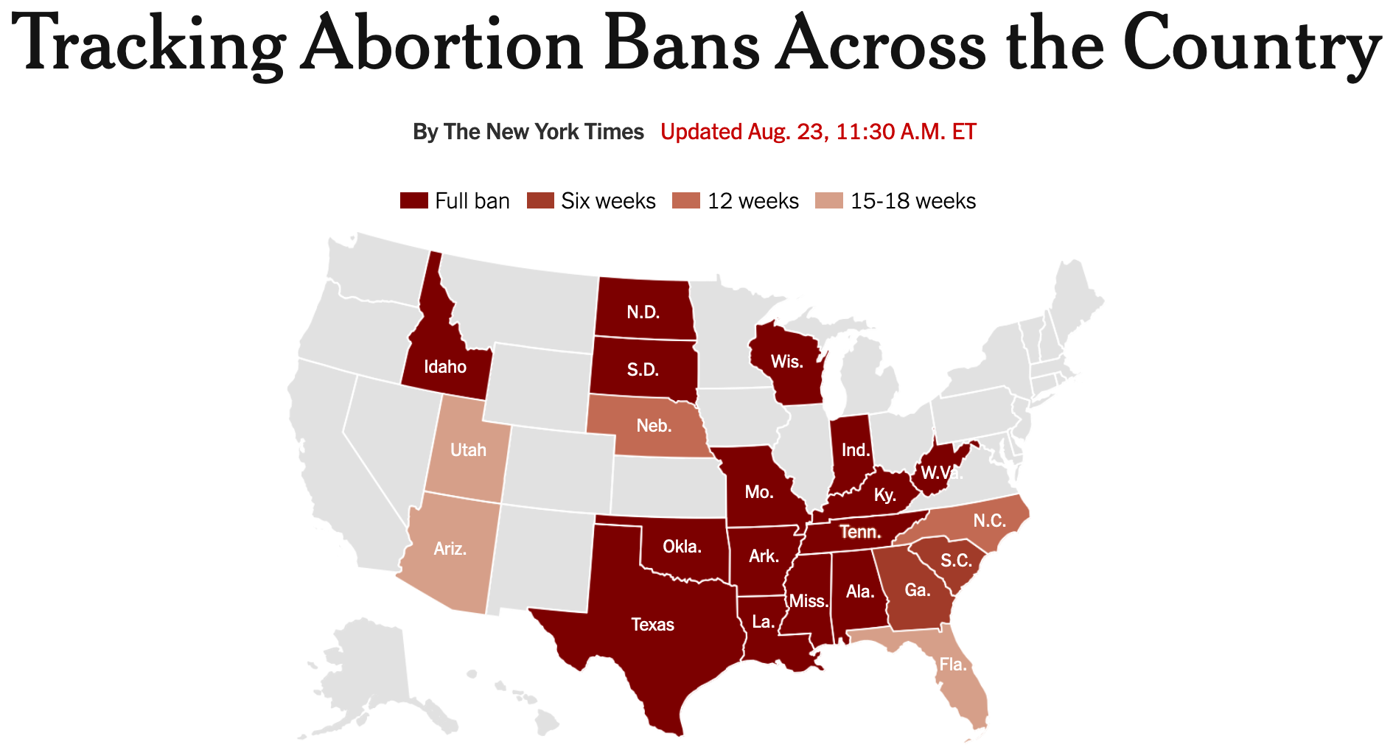
Migration is a political phenomenon
People vote with their feet
public choice theory and consumer-voter model (Dye 1990; Tiebout 1956)
Sub-national Policy
economic policy such as tax policy
education expenditure
women’s rights such as abortion right
Introduction | Background | Hypotheses | Data&Methods | Results | Discussion
Notes:
In the American internal migration case, politics matters because Many policies happen below the federal level: creating a lot of heterogeneities across space

Slide 14
Migration is a political phenomenon
Local political climate
Spillover effects of policy: e.g., immigrant policy affects the sense of belonging of Latinos, including U.S.-born Latinos (Schildkraut et al. 2019)
Political ideology as place-based social identity (Cramer 2016; Hochschild 2018)
Homophily (McPherson et al. 2001)
Claim: people stay in and migrate towards places that match their political leanings
Introduction | Background | Hypotheses | Data&Methods | Results | Discussion
Notes:
The social identity reflects on everyday lives: leisure activities, cultural consumptions. liberals drink latte, and the conservatives hunt birds
cultural consumption
Research about Trumpism: why voters support candidates and policies that can actually hurt their own interests
Political consciousness that is strongly attached to the social identity people get from their localities they reside in

Slide 15

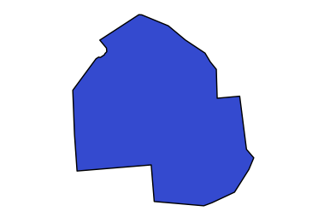
Analytical Approach
How to study migration as a political phenomenon?
Correlates migration patterns of a place with its political climate (e.g., Preuhs 1999)
Orange, CA | Hennepin, MN
Obama receives 47.6% | Obama receives 63.4%
Net migration -11,050 -0.3% | Net migration -1,088 -0.1%
...
...
...
...
Introduction | Background | Hypotheses | Data&Methods | Results | Discussion
Notes:
In other words, how is political environment associated with a place's attractiveness?
-Only internal migration; not counting fertility, mortality, or international migration
OC: -0.3%; MN: -0.1%

Slide 16

Analytical Approach
Study immigration without knowing the origin
Study emigration without knowing the destination
Viewing migration as a characteristics of a place divides migration into two separated processes: im-migration and e-migration
?
?
Introduction | Background | Hypotheses | Data&Methods | Results | Discussion

Slide 17

Analytical Approach
Migration, people moving from one place to another, is a relational phenomenon
The relational approach shifts the analytical unit from a place to a pair of places
We consider how the origin and destination jointly influences migration between them
Minneapolis (MN)
Jacksonville (FL)
Introduction | Background | Hypotheses | Data&Methods | Results | Discussion

Slide 18


Migration Systems
Migration flows between places form an interconnected system (migration systems theory: DeWaard & Ha 2019; Mabogunje 1970)
Migration flow network
counties (nodes)
migration flows (edges)
RQ: what explains the magnitudes of migration flows between counties
Introduction | Background | Hypotheses | Data&Methods | Results | Discussion
Notes:
It took the field a few decades to collect and process data, and develop methods to empirically analyze this
acknowledge the great work done by Jake DeWaard
laid a solid foundation for this field; and this paper is built on his works
Two components of migration flow networks (in network terms, nodes)
North Slope, AK
Monroe county, FL (Keywest)
Although the idea was there, it was not until recently that we are able to put that into extensive empirical study, because of the data and methodological hurdles that we will need to overcome
To be fair, this relational and systemic thinking is not a new idea; but it is very important in our analysis here, and there are some technical issues that we need to solve to make it work in this large system

Slide 19

Political Polarization
The relational view puts in context the political polarization across geography:
Political polarization has divided Americans along party lines, spatially
“The big sort” (Bishop & Cushing 2009)
Segmentation of American geography by partisanship
“A large proportion of voters live with virtually no exposure to voters from the other party in their residential environment” (Brown & Ethos 2021)
Introduction | Background | Hypotheses | Data&Methods | Results | Discussion
Notes:
Taking this relational view into the political analysis of migration
Brown & Ethos: measures the closest 1k neighbors

Slide 20
Political Polarization
Political polarization is not only spatial, but also affective:
Americans today regard people from the other party with suspicion and hostility (Iyengar et al. 2019)
Migration is less likely to happen across party lines
H1: the more dissimilar counties are in their political climate, the less the migration flow between them.
Introduction | Background | Hypotheses | Data&Methods | Results | Discussion
Notes:
Moving from a blue county to a red one, the potential migrants would really have to think twice
-This is something that we wouldn’t see if we don’t take a relational review

Slide 21
Segmented Immobility
The relational view reveals connection between segmentation & immobility
Segmentation across geography in their social environments (e.g., political climate)
Tendency of avoiding boundary crossing
Segmented immobility: limited population exchange between geographical segments with dissimilar social environments
Introduction | Background | Hypotheses | Data&Methods | Results | Discussion
Notes:
If we generalize this idea, it brings us to the concept that I theorize in the paper called segmented immobility

Slide 22
Segmented Immobility
Rural-urban division:
H2: the more dissimilar counties are in their levels of urbanization, the lower the migration flow between them.
Racial segregation:
H3: the more dissimilar counties are in their racial compositions, the lower the migration flow between them.
Introduction | Background | Hypotheses | Data&Methods | Results | Discussion
Notes:
rural Kansas to Manhattan
economic conditions: jobs

Slide 23
Data and Variables
Predict migration flows
annual count of migrants between all directed pair of the 3,142 counties in 2011-2015
from the American Community Survey (ACS)
Introduction | Background | Hypotheses | Data&Methods | Results | Discussion
Notes:
ACS average across five years before releasing the data, to get enough confidence in the small county migration info. Aggregate-level data

Slide 24
Data and Variables
Effects of segmented immobility
Political dissimilarity: absolute difference in % Democratic votes in 2008 presidential election
Rural dissimilarity: absolute differences in % of urban population in 2010
Racial dissimilarity: dissimilarity score of racial compositions in 2010
Introduction | Background | Hypotheses | Data&Methods | Results | Discussion
Notes:
We use the Census 2010 definition of race and ethnicity: NH-White, NH-Black/Afri, NH-Asian, Hisp, other races

Slide 25
Data and Variables
Control covariates (2010 Census, 2006-10 ACS)
international immigrant inflows
demographic: population size and density, age structure, origin racial composition
economic: homeownership %, higher-ed %, unemployment rate, housing costs
geographic: distance, same state, region fixed effects
Introduction | Background | Hypotheses | Data&Methods | Results | Discussion
Notes:
mention some key covariates

Slide 26

Methods
Exponential-family random graph models (ERGMs) for valued networks (Krivitsky 2012)
Roughly a generalization of Poisson regression
Orange, CA → Hennepin, MN | Hennepin, MN → San Diego, CA
Political dissimilarity 15.8% | Political dissimilarity 9.27%
Migrant count 120 | Migrant count 362
...
...
...
Introduction | Background | Hypotheses | Data&Methods | Results | Discussion
Notes:
This sounds easy; but I assure you it is not

Slide 27
Methods
Challenge 1: it is not a regression
“autocorrelation”: migration flows correlate with each other
e.g., OC->Clark & Clark->OC
theoretical insights about the migration systems: “internal dynamics” (de Haas 2010)
theorize, formalize, and measure the internal dynamics in network analysis (more in the paper)
Introduction | Background | Hypotheses | Data&Methods | Results | Discussion
Notes:
Can skip these two challenge slides if time is limited

Slide 28

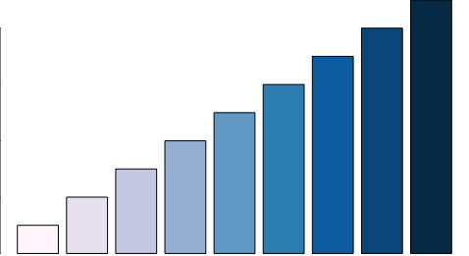

Methods
Challenge 2: very difficult to compute
network analysis mostly focuses on binary social relations; valued network analysis less developed
big network: 9.9million county-pairs
subsampled parallelable maximum pseudo-likelihood estimation
Binary
Valued
Introduction | Background | Hypotheses | Data&Methods | Results | Discussion

Slide 29
Immobility from political division
Counties with higher democratic voter share
receives more migrants from a blue county
and sends more migrants to a blue county
Introduction | Background | Hypotheses | Data&Methods | Results | Discussion
Notes:
Each dot represents a county
McCain
This is bivariate correlation: what if we control other factors, including the internal dynamics

Slide 30
Inter-county Migration Flows 2011-15
 | Estimate |  | Std.Err
Segmented Immobility
Political dissimilarity | -0.256 | *** | 0.007
Rural dissimilarity | -0.399 | *** | 0.004
Racial dissimilarity | -0.217 | *** | 0.006
Control Covariates | (included)
Note: ***p < 0.001 (two-tailed tests)
Fewer people migrate between counties with dissimilar political contexts, levels of urbanization, and racial compositions
Segmented Immobility
people are less likely to migrate when it involves crossing a boundary towards a distinct socio-political environment
Introduction | Background | Hypotheses | Data&Methods | Results | Discussion
Notes:
For a typical research paper, we will stop here after the hypothesis testing, but there is still an unfinished business
How much does this pattern contributed to the immobility?

Slide 31
Knockout experiment
How much does segmentation contribute to immobility?
A counterfactual scenario where segmentation does not influence migration
Knock out the effects (coefficients), and simulate
Compare total number of inter-county migrants in counterfactual scenarios to the observed
 | Estimate
Segmented Immobility
Political dissimilarity | -0.256 | ***
Rural dissimilarity | -0.399 | ***
Racial dissimilarity | -0.217 | ***
0
0
0
Introduction | Background | Hypotheses | Data&Methods | Results | Discussion
Notes:
close your eye and think about an imagined world where there is no political difference, “and the world will be as one” (as John Lennon once imagined)

Slide 32




Knock-out Experiments
 | Total Migrants | Diff. in # and rate | Diff in %
Observed | 17,176,675
\ political segmentation | 17,965,336 | +788,661 | +4.6%
\ all segmentation | 21,741,021 | +4,564,346 | +26.6%
In a world without segmented immobility,
there would be 26.6% more inter-county migrants, 4.6 million more people moving from one county to another each year.
11⨉
15⨉
Introduction | Background | Hypotheses | Data&Methods | Results | Discussion
Notes:
ChatGPT drew these two pictures
That’s how AI thinks about the Twin Cities

Slide 33
Conclusion
A relational analysis of inter-county migration flow system offers new insights about immobility
Segmented immobility: migration is suppressed between counties with dissimilar political environments, levels of urbanization, and racial compositions
A pattern that could potentially hinder millions of people from migrating each year based on knockout experiments
Introduction | Background | Hypotheses | Data&Methods | Results | Discussion

Slide 34
Discussion
Segmented immobility suggests a limited population exchange between communities with different cultural, political, and racial environments
Not only a mechanism of immobility
But can also lead to segregation and polarization of people with different identities and/or beliefs (Fossett 2006; Sakoda 1971; Schelling 1969)
There exists an intrinsic relationship among immobility, segregation, and polarization
Introduction | Background | Hypotheses | Data&Methods | Results | Discussion

Slide 35
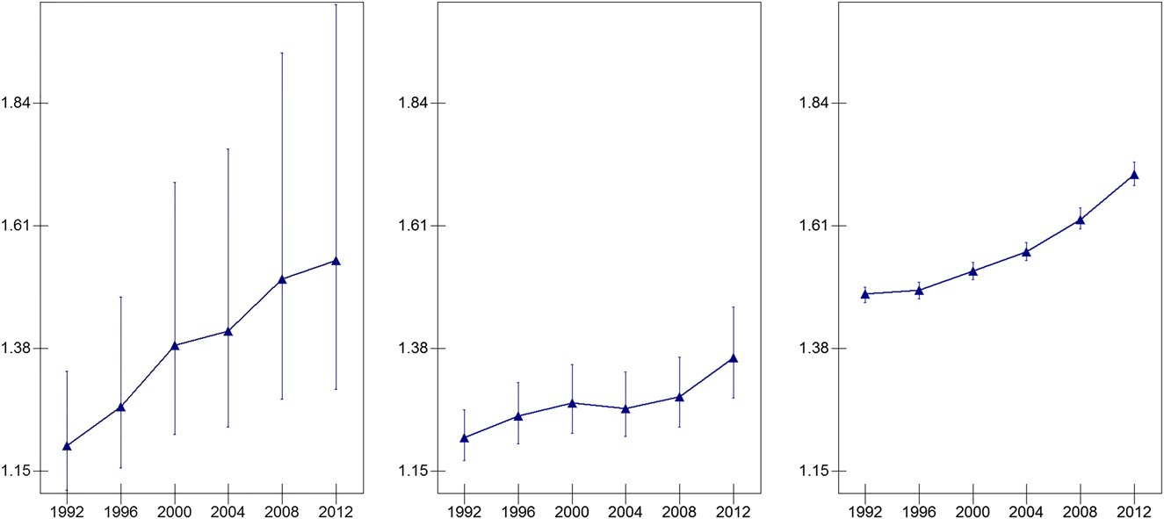
Next Steps
Longitudinal analysis: growing immobility & political polarization
ACS migration flow data starts in 2006
Median Odds Ratio
Political polarization at the county, state, and division levels (Johnston et al. 2016)
Notes:
there are other datasets, such as IRS tax data; they have pros and cons
growing polarization across geographical space over time
(Median odds ration: ratio between highest voting rate and lowest rate, and get median across all pairs)

Slide 36
Future Projects
Post-pandemic internal migration
International visa-waiver policy network
stratification of global migration opportunities
Global migration flow system
climate change and political violence
short-term and long-term impacts via simulation
Notes:
w/ Jacob Thomas
-push this into a series of research (war on terror & national security; global health crisis: pandemic)
w/ Jeff Johnson

Slide 37
Thank you
Peng Huang
Email: peng.huang@uci.edu
Website: www.penghuang.me

Slide 38
Change of political geography
Median odds ratios at the county, state, and division levels (Johnson et al. 2016)
Political Polarization has grown stronger across geography at three spatial scales

Slide 39
Full Model

Slide 40
Inter-county Migration Flows 2011-15
 | Estimate |  | Std.Err
Network patterns
Reciprocity | 0.045 | *** | 0.002
Log(past migrant flow) | 0.300 | *** | <0.001
Waypoint flow | -0.015 | *** | 0.001
Control Covariates
Note: ***p < 0.001 (two-tailed tests)
Significance of internal dynamics of the migration flow system
Strong patterns of reciprocity and perpetuation
A suppression of waypoint structure (implications on the scale of chain-like migration)
Introduction | Background | Hypotheses | Data&Methods | Results | Discussion

Slide 41
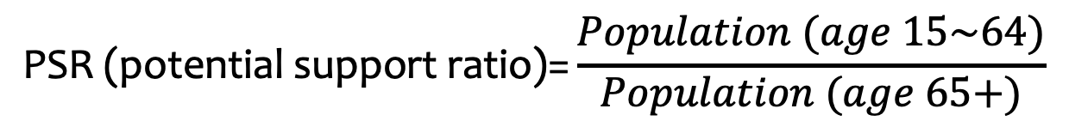
Inter-county Migration Flows 2011-15
 | Estimate |  | Std.Err
Demographics
Destin.log(immigrant inflow) | 0.056 | *** | 0.001
Origin.log(immigrant inflow) | 0.035 | *** | 0.001
Destin.log(population size) | 0.351 | *** | 0.002
Origin.log(population size) | 0.373 | *** | 0.001
Destin.log(population density) | -0.083 | *** | 0.001
Origin.log(population density) | -0.069 | *** | 0.001
Destin.PSR | 0.017 | *** | 0.001
Origin.PSR | 0.013 | *** | 0.001
Note: ***p < 0.001 (two-tailed tests)
$$\text{PSR} \text{(}\text{potential} \text{support} \text{ratio}\text{)=}\frac{Population (age 15\sim 64)}{Population (age 65+)}$$
Introduction | Background | Hypotheses | Data&Methods | Results | Discussion

Slide 42
Inter-county Migration Flows 2011-15
 | Estimate |  | Std.Err
Origin racial demographics
Origin.P(White) | (reference group)
Origin.P(Hispanic) | -0.064 | *** | 0.007
Origin.P(Black) | 0.117 | *** | 0.008
Origin.P(Asian) | -0.467 | *** | 0.020
Origin.P(other race) | 0.993 | *** | 0.015
Baseline
Sum | -1.193 | *** | 0.040
Nonzero | -13.917 | *** | 0.028
Note: ***p < 0.001 (two-tailed tests)
Introduction | Background | Hypotheses | Data&Methods | Results | Discussion

Slide 43
Inter-county Migration Flows 2011-15
 | Estimate |  | Std.Err
Economics
Destin.P(renter) | 0.348 | *** | 0.011
Origin.P(renter) | 0.476 | *** | 0.012
Destin.P(higher education) | 0.359 | *** | 0.011
Origin.P(higher education) | 0.153 | *** | 0.012
Difference.log(housing costs) | -0.153 | *** | 0.004
Origin.log(housing costs) | -0.277 | *** | 0.005
Difference.P(unemployment) | -1.300 | *** | 0.040
Origin.P(unemployment) | -3.012 | *** | 0.052
Note: ***p < 0.001 (two-tailed tests)
Introduction | Background | Hypotheses | Data&Methods | Results | Discussion

Slide 44
Inter-county Migration Flows 2011-15
 | Estimate |  | Std.Err
Geographics
Log(distance) | -0.568 | *** | 0.001
Same state | 0.510 | *** | 0.002
Northeast | (reference group) | *** | 0.011
Destin.South | 0.253 | *** | 0.003
Origin.South | 0.046 | *** | 0.003
Destin.West | 0.374 | *** | 0.004
Origin.West | 0.184 | *** | 0.004
Destin.Midwest | 0.197 | *** | 0.003
Origin.Midwest | 0.080 | *** | 0.003
Note: ***p < 0.001 (two-tailed tests)
Introduction | Background | Hypotheses | Data&Methods | Results | Discussion

Slide 45
Inter-county Migration Flows 2011-15
 | Model 1 |  | Model 2
Segmented Immobility
Political dissimilarity | -0.368 | *** | -0.256 | ***
Rural dissimilarity |  |  | -0.399 | ***
Racial dissimilarity | -0.361 | *** | -0.217 | ***
Control Covariates | (included) |  | (included)
Note: ***p < 0.001 (two-tailed tests)
Introduction | Background | Hypotheses | Data&Methods | Results | Discussion

Slide 46
Future Projects

Slide 47
Future Projects
International migration systems
Evolution of global visa-waiver network
with Jacob Thomas (CUHK)
socio-cultural affinity; security: terrorism and global pandemic; international relations
Evolution of international migration flows
with Jeffrey Johnson (UoF)
political violence, and climate change
short-term & long-term impacts via simulation
longitudinal valued network models
Notes:
socio-cultural affinity, security, international relations
short-term and long-term impacts; regional and global analyses

Slide 48
Future Projects
Spatial network and neighborhood effects
with John Hipp (UCI), Carter Butts (UCI), Zack Almquist (UW), and Loring Thomas (Princeton)
spatial distribution of social contact in urban areas
health risks and exposure to crime
varying social connection patterns by race, ethnicity, and sex
Notes:
socio-cultural affinity, security, international relations
short-term and long-term impacts; regional and global analyses

Slide 49
Future Projects
Migrant Social Networks
Diffusion of migration opportunities
Migrant-sending areas in Southeastern China
Archival data on transportation network, economic structures, and lineage networks
Immigrant integration
change of social networks over time and generation

Slide 50
Future Projects
Methodology and mathematical sociology
temporal models for valued network analysis
stochastic process of valued network models
network regression (MR-QAP) for discrete data
Simulation models for immobility and segregation (empirically calibrated)

Slide 51
Methods

Slide 52
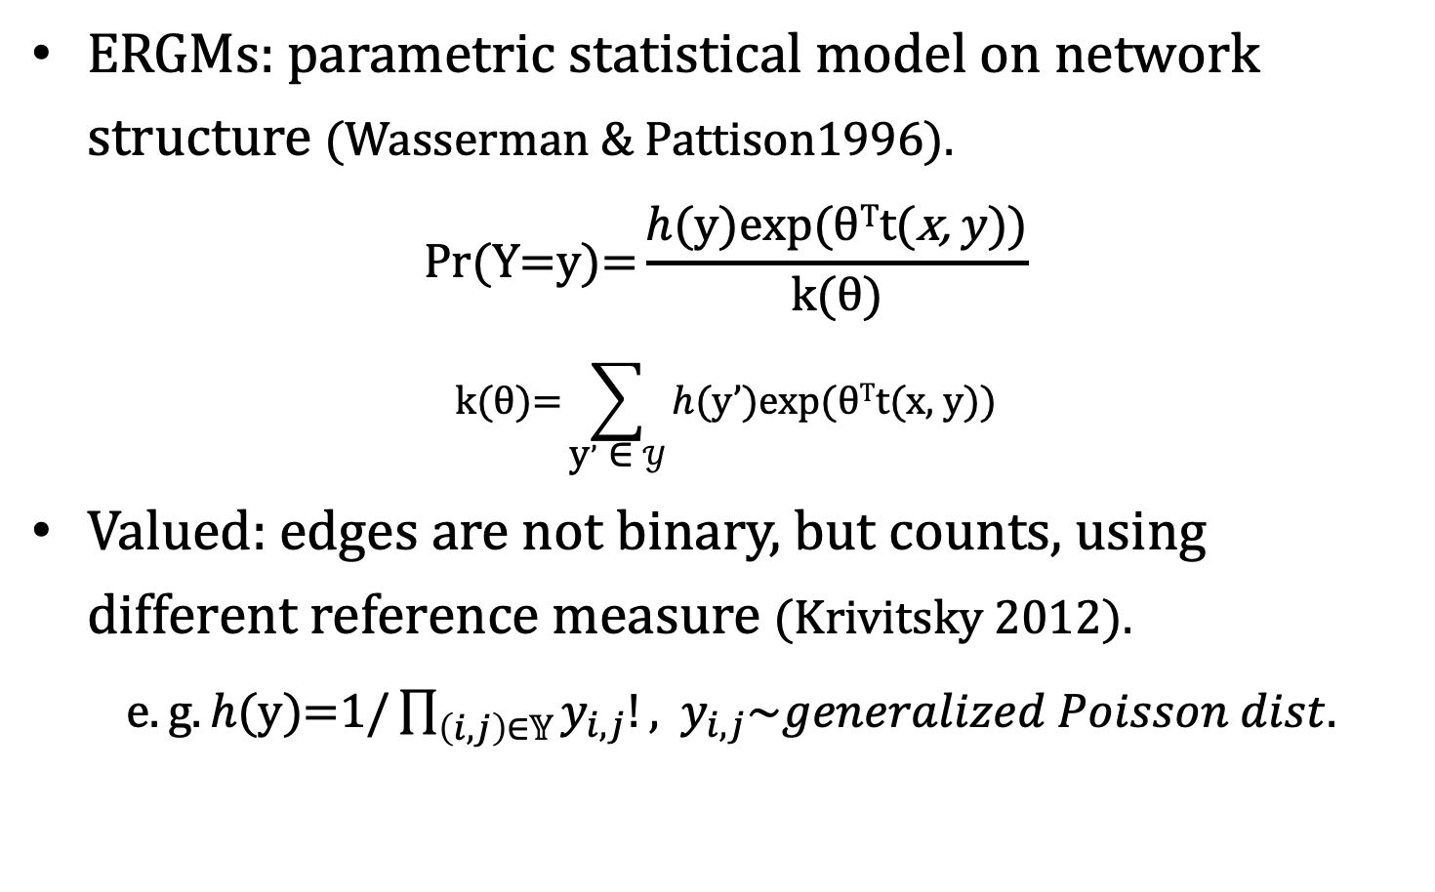
Valued ERGMs
ERGMs: parametric statistical model on network structure (Wasserman & Pattison1996).
$$\text{P}\text{r}\text{(}\text{Y}\text{=}\text{y}\text{)=}\frac{h(\text{y}\text{)}\text{exp}\text{(}\text{θ}\text{T}\text{t}\text{(}\text{x}\text{, }y\text{)}\text{)}}{\text{k}\text{(}\text{θ}\text{)}}$$
$$\text{k}\text{(}\text{θ}\text{)}\text{=}\sum_{\text{y}’ \text{∈} 𝒴}{h(\text{y}’\text{)}\text{exp}\text{(}\text{θ}\text{T}\text{t}\text{(}\text{x}\text{, }\text{y}\text{)})}$$
Valued: edges are not binary, but counts, using different reference measure (Krivitsky 2012).
$e.g. h(\text{y}\text{)=1/}\prod_{\left(i,j\right)∈𝕐}{y_{i,j}!}\text{,}{ y}_{i,j}\sim generalized Poisson dist.$

Slide 53
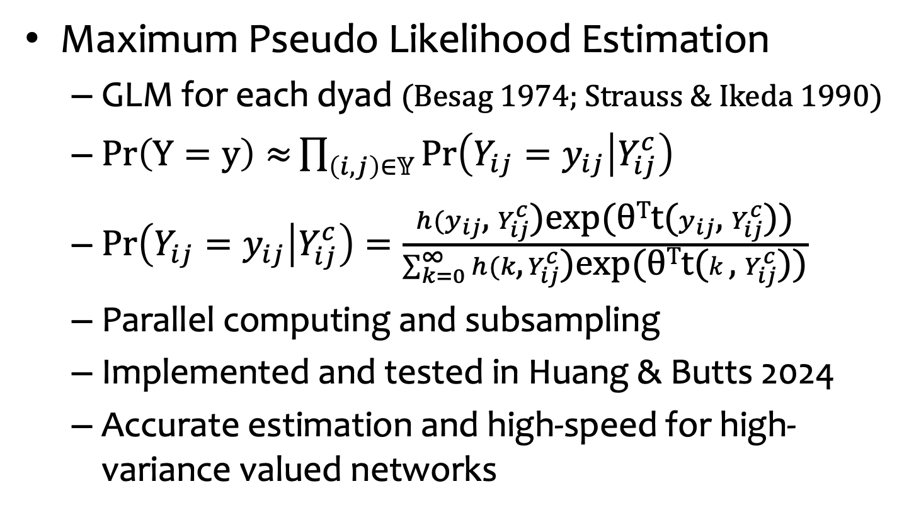
MPLE
Maximum Pseudo Likelihood Estimation
GLM for each dyad (Besag 1974; Strauss & Ikeda 1990)
$Pr\left(Y=y\right)≈{\prod_{\left(i,j\right)∈𝕐}{Pr\left(Y_{ij}=y_{ij} | Y_{ij}^{c}\right)}}$
$\operatorname{Pr}\left(Y_{ij}=y_{ij} | Y_{ij}^{c}\right)=\frac{h(y_{ij}\text{, }Y_{ij}^{c}\text{)}\text{exp}\text{(}\text{θ}\text{T}\text{t}\text{(}y_{ij}\text{, }Y_{ij}^{c}\text{))}}{\sum_{k=0}^{∞}{h(k\text{, }Y_{ij}^{c}\text{)}\text{exp}\text{(}\text{θ}\text{T}\text{t}\text{(}k\text{, }Y_{ij}^{c}\text{))}}}$
Parallel computing and subsampling
Implemented and tested in Huang & Butts 2024
Accurate estimation and high-speed for high-variance valued networks
Notes:
are able divide and conquer
we should call it Count ERGMs
there are other types, like signed graphs, Garry's categorical, ordinal
Valued ERGMs for count data: when talking about things that are only true for count data
But we can talk about Valued ERGMs in the paper, to connect with that school of literature. Only make sure we don't overclaim in the paragraphs
substantive example: Martin's dissertation project

Slide 54
Internal Dynamics
Migration Systems Theory

Slide 55
Migration Systems
The interdependence of migration flows
e.g., Reciprocity
Migration flows between places form an interconnected system (MST)
Not only a remedy of autocorrelation, but also reveals the internal dynamics of the system
“a circular, interdependent, progressively, complex, and self-modifying system in which the effect of changes in one part can be traced through the whole of the system” (Mabogunje 1970:16)
Introduction | Background | Hypotheses | Data&Methods | Results | Discussion

Slide 56
Internal dynamics: reciprocity
Interdependence of migration flows
Transnationalism: migration is an enduring reciprocal exchange of people, goods, and cultures between sending and receiving countries (Schiller, Basch, and Blanc 1995; Waldinger 2013)
Internal Migration: “Counter-currents of migration” (Ravenstein 1885: 187)
H4: Ceteris paribus, migration flow from county A to county B increases with the migration flow from B to A
Introduction | Background | Hypotheses | Data&Methods | Results | Discussion
Notes:
return migration
flow triggers its opposite flow by bringing information and social connection

Slide 57
Internal dynamics: perpetuation
Cumulative causation: migration alters the social contexts in ways that make future migration more likely (Massey 1990; Massey et al. 1993)
migrant networks, information, resources, and institutional changes
H5: Ceteris paribus, the flow of migration from county A to B increases with the past flow of migration from county A to county B.
Introduction | Background | Hypotheses | Data&Methods | Results | Discussion
Notes:
change in economic structure: change in market: emigration of labors makes it harder to run the business, further driving more emigration

Slide 58
Internal dynamics: waypoint flow
Waypoint: balanced immigration and emigration flow, like a transfer station
Result from chain-like migration (Leal 2021)
stepwise migration: multi-stops migration process
relay migration: immigration drive emigration or the reverse
H6: Ceteris paribus, the inflows of migration to a county increase with its outflows.
Introduction | Background | Hypotheses | Data&Methods | Results | Discussion

Slide 59
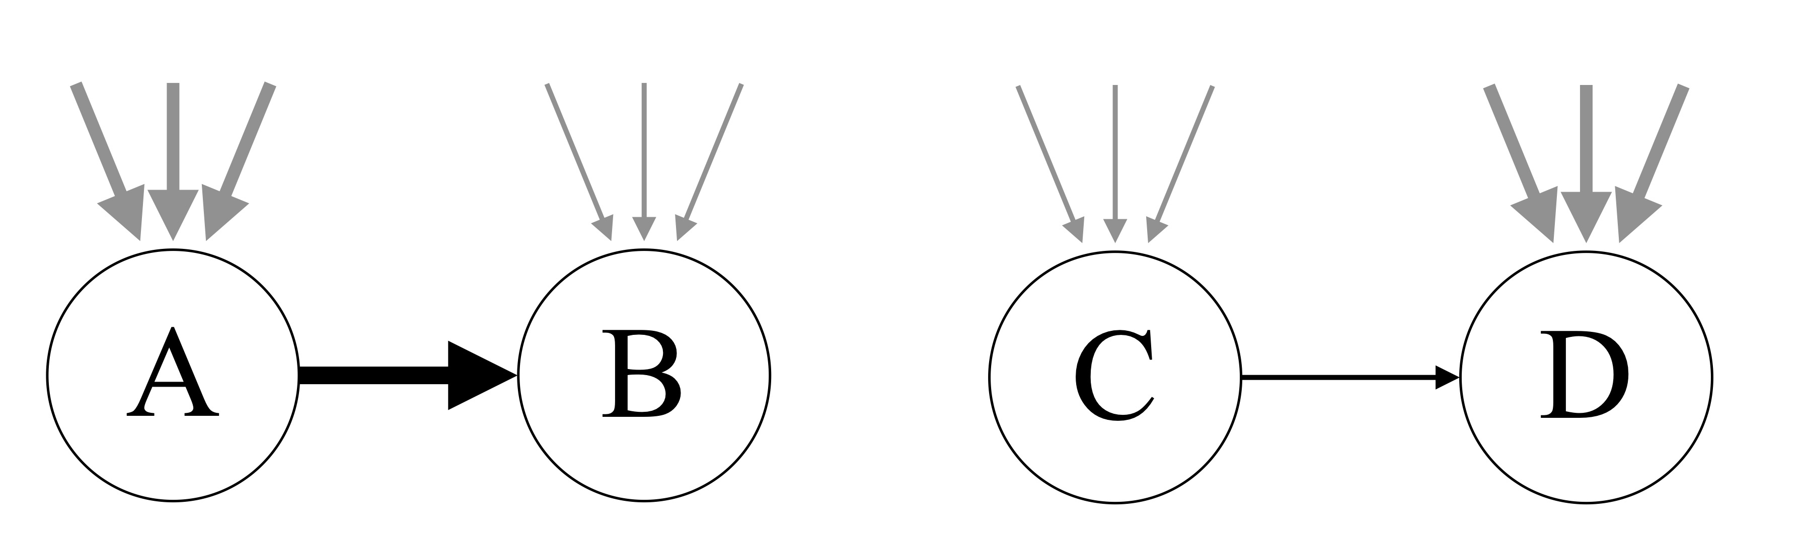
Internal & international migration
Demographic balkanization (Frey 1995): immigrant inflows 1) trigger outflows and 2) deter inflows
Conflicting empirical findings (Borjas 2006; Card 2001; White & Liang 1998; Wright, Ellis & Reibel 1997 )
H7: Ceteris paribus, an internal migration flow increases with international immigration inflow in the sending county, but decreases with international immigration inflow in the receiving county..
Introduction | Background | Hypotheses | Data&Methods | Results | Discussion

Slide 60
Data and Variables
Internal dynamics
Reciprocity
Perpetuation
past migration flow in 2006-10 (in log)
Waypoint flow
Introduction | Background | Hypotheses | Data&Methods | Results | Discussion

Slide 61
Conclusion
A relational approach to study inter-county migration flow system using network methods
Internal dynamics of migration: reflected by interdependence of migration flows, such as reciprocity, suppression of waypoint
lend empirical evidence to the systemic theory of migration: an interdependent network system that carries its own momentum
Introduction | Background | Hypotheses | Data&Methods | Results | Discussion

Slide 62
Discussion
Segmented immobility (SI) suggests a limited population exchange between communities with different cultural, political, and racial environments
Not only a mechanism of immobility
It opens the door for the inquiry about the relationship between immobility, segregation, and polarization
Migration process has always been at the core of segregation model (Fossett 2006; Sakoda 1971; Schelling 1969), but more needs to be done
Introduction | Background | Hypotheses | Data&Methods | Results | Discussion

Slide 63
Discussion
Segregation
Immobility
Polarization
Introduction | Background | Hypotheses | Data&Methods | Results | Discussion
Notes:
We identify segregation -> immobility; but other relationships can be possible
Segregation of culturally and politically different community across space offers an infrastructure for immobility to happen because of the avoidance to migrating across the line
Immobility in turn can maintain and even strengthen segregation process given a lack of exchange between segments
They together create an environment that fuels polarization, as the lack of contact in the long-term tends to ignite misunderstanding and prejudice
And the growing polarization could in turn strengthen the tendency in segmented immobility, bonding segregation and immobility in a stronger way
These are some theoretical models that hopefully this paper can inspire. But if we return to the paper, what’s the takeaway?

Slide 64
Clarifications

Slide 65
Economists’ puzzle
Demographic and labor market structures has little explanatory power to the low mobility rate
“[demographic and employment type] composition and the returns to migration have limited ability to explain recent changes in interstate migration” (Hyatt et al. 2018)
“We find little support for several explanations, including the rise of dual-career households, the decline in middle-skill jobs, occupational licensing, and the need for employees to retain health insurance.” (Molloy et al. 2017)

Slide 66
Segmented Immobility
Rural-urban division
economic reasons: specialized human capital
cultural reasons: lifestyle
Racial Segregation
economic reasons: ethnic capital (Fernandez-Kelly 2008; Lee and Zhou 2017)
cultural reasons: cuisine, religious practice, etc.
Notes:
(latte vs bird hunting)

Slide 67
Immobility

Slide 68
An Inquiry of Immobility
What inhibits migration?
The state (Waldinger & Fitzgerald 2004)
International migration: passport-visa-border control-enforcement & removal
The nature of immigration politics & policies is restriction (Lahav & Messina 2023)
Once we enter a country without state control over domestic migration (e.g., USA), we should enjoy a lot of mobility, right?
Introduction | Background | Hypotheses | Data&Methods | Results | Discussion

Slide 69
Immobility is not the flip side of mobility
We have studied extensively about what empowers people to migrate (financial, social, political capital etc.)
This framework can make us assume that immobility is a failure to migrate (without those empowerment)
BUT both mobility and immobility can be voluntary choices, reflecting different cultures
“culture of migration” & “culture of staying” (Stockdale & Haartsen 2018)

Slide 70
Immobility is not the flip side of mobility
In the marginal analysis, in-migration and out-migration are not distinguishable
neither are mobility and immobility
high net in-migration rate can be due to large in-flow (mobility) or small out-flow (immobility), or both
The relational analysis directly focuses on the magnitude of migration flow
the variation of interest is mobility vs immobility
Notes:
Mobility is given, so we focus on the variation among migration
If a place is attractive, it increases in-migration, and increases non-migration of current residents; we are not distinguishing the twox
-of course this is a general tendency, not a strictly enforced boundary

Slide 71
Immobility is not the flip side of mobility
Different focuses inspires us to ask different questions
e.g., “voting with your feet”
Mobility: variation among migration
blue->red vs. red->blue? what policy/climate attracts more migrants
Immobility: variation between migration and non-migration
what stops people from making a move? an environment they do not identify with?
Notes:
Mobility is given, so we focus on the variation among migration
If a place is attractive, it increases in-migration, and increases non-migration of current residents; we are not distinguishing the twox
-of course this is a general tendency, not a strictly enforced boundary

Slide 72
Discussion
“While internal migration in the U.S. does not involve border-crossing for international migration or other forms of governmental restrictions, population movement is never free of constraints.”
“Rather, Americans today are separated by the invisible borders and walls standing along the party lines, at the midway between rural and urban landscapes, and over the gap across communities with varying racial demographics.”
Introduction | Background | Hypotheses | Data&Methods | Results | Discussion
Notes:
I would like to end my presentation with two quotes from this paper, that hopefully will be your takeaways from this talk

Slide 73
Appendix
Descriptive statistics
Adequacy check

Slide 74
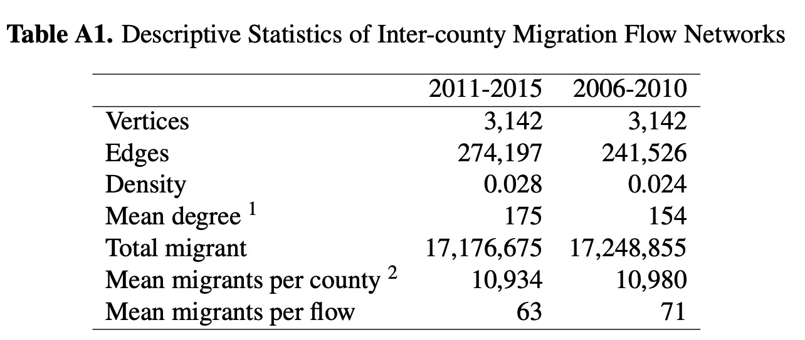
1. The reported degree is the total degree (Freeman degree), which equals the summation of in and out degree (Freeman 1978). For a closed network system, the mean in-degree equals to the mean out-degree.
2. Similarly, the mean migrant per county is the summation of mean in-migrants and mean out-migrants per county (and mean in-migrants equals to mean out-migrants).

Slide 75
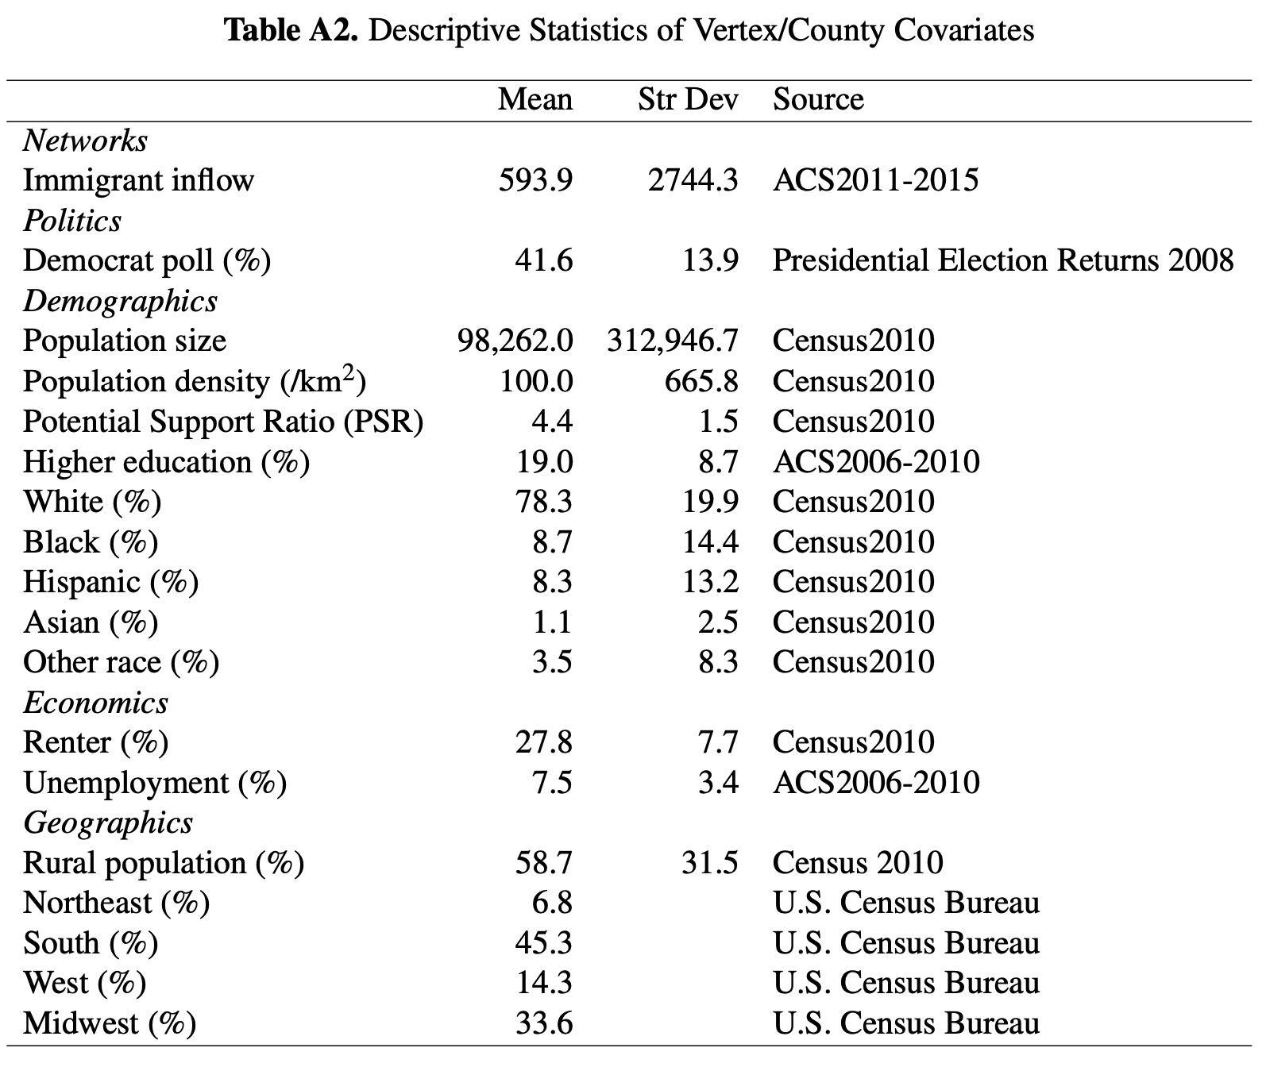

Slide 76
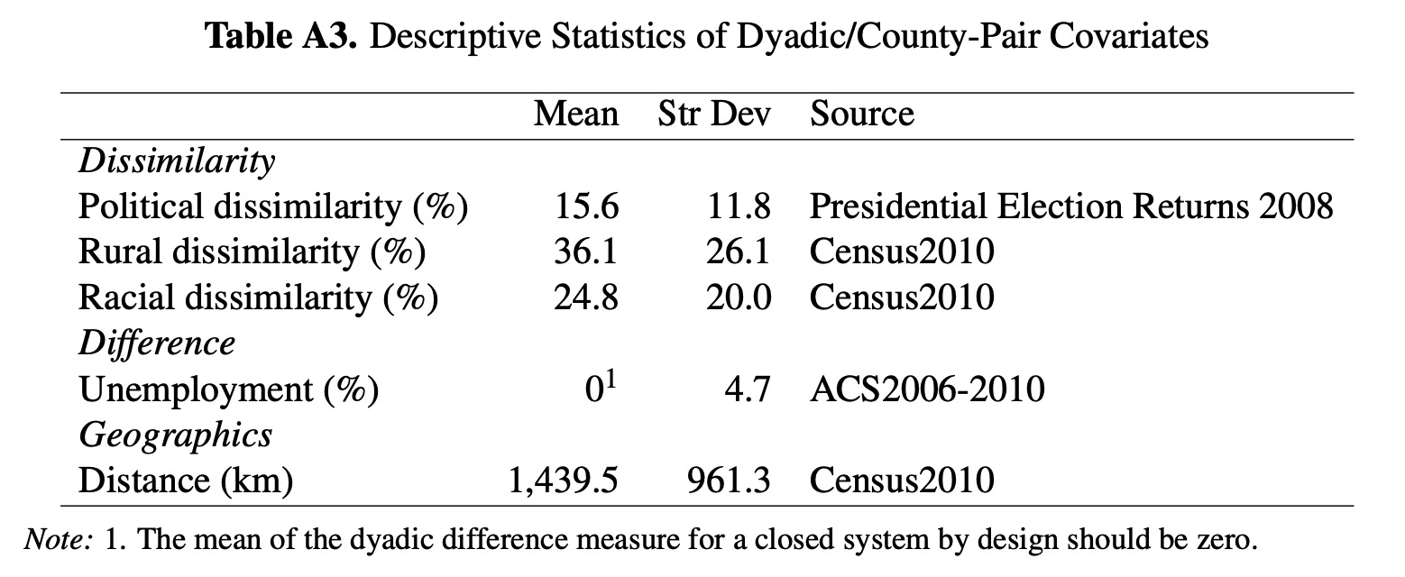

Slide 77
Adequacy check

Slide 78
California Exodus
Population Redistribution

Slide 79
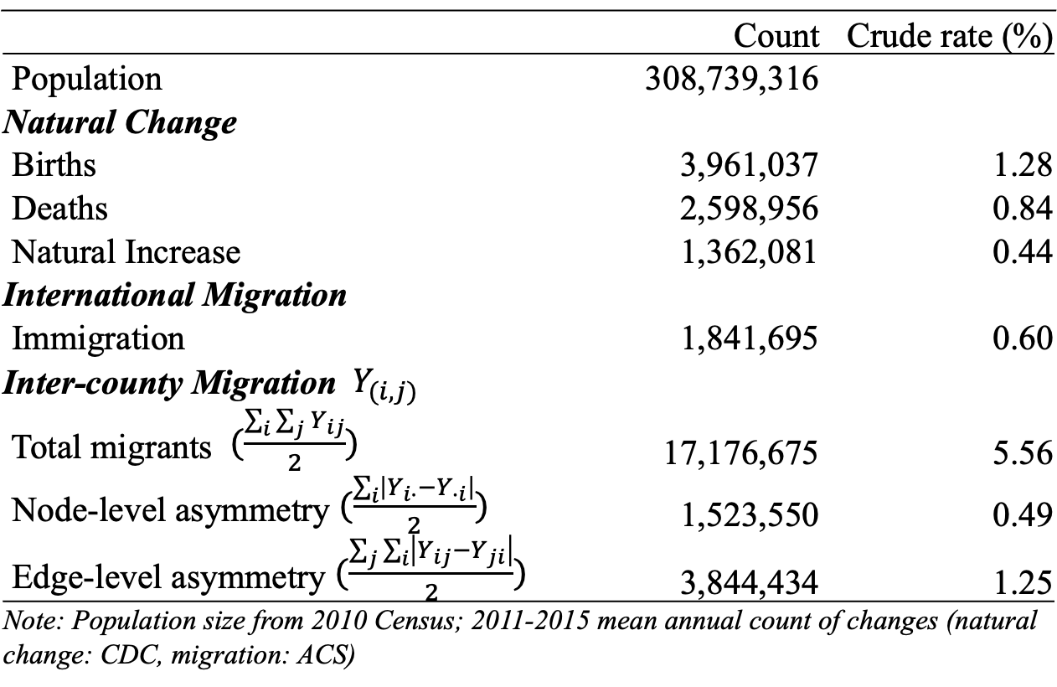
U.S. Population System
 | Count | Count | Crude rate (%)
Population | 308,739,316 | 308,739,316
Natural Change
Births | 3,961,037 |  | 1.28
Deaths | 2,598,956 |  | 0.84
Natural Increase | 1,362,081 |  | 0.44
International Migration
Immigration | 1,841,695 |  | 0.60
Inter-county Migration ${ Y}_{(i,j)}$
Total migrants $(\frac{\sum_{i}{\sum_{j}{Y_{ij}}}}{2})$ | 17,176,675 |  | 5.56
Node-level asymmetry $(\frac{\sum_{i}{\left|Y_{i∙}−Y_{∙i}\right|}}{2})$ | 1,523,550 |  | 0.49
Edge-level asymmetry $(\frac{\sum_{j}{\sum_{i}{\left|Y_{ij}−Y_{ji}\right|}}}{2})$ | 3,844,434 |  | 1.25
Note: Population size from 2010 Census; 2011-2015 mean annual count of changes (natural change: CDC, migration: ACS)
Notes:
(May be able to get maximum of emigration by looking at DHS data

Slide 80
Net Migrant Count
$Y_{∙i}−Y_{i∙}$
California has large migrant population loss

Slide 81
Net Migration Rate
${(Y_{∙i}−Y_{i∙})}/{P_{i}}$
Not very different from the majority of states after controlling for population
Notes:
Normalized by Population Size

Slide 82
Migration Imbalance Index
${(Y_{∙i}−Y_{i∙})}/{(Y_{∙i}+Y_{i∙})}$
External-Internal (E-I) Index (Krackhardt & Stern 1988)
Larger variation in imbalance of in-&out- flows
California is among the lower ends
Notes:
Normalized by Population Size

Slide 83
Possible Drivers of Exodus
Compared to other U.S. states, California has more
Democratic-party voters
expensive housing
minority population
urban population
Notes:
This is to show that the environment Californians are exposed to are different from others: there are some gradient

